Slide 1


World electricity analysis
Ashish sahu

Slide 2
Overview:-
This analysis contain information about the electrification by different countries and different groups of countries for the population of urban, rural, and overall population (urban + rural).
The different sources of electricity generation are analyzed like nuclear, oil, and renewable.
Different countries are taken into consideration and collected the data for 1960 – 2020 or 1960 - 2014 but the data has missing values and mostly before the year 2000, the number of missing data is very high, so for most of our analysis, we use 2000 – 2020 data.
Also analyzed the electric power transmission and generation loss.
Click to dashboard

Slide 3
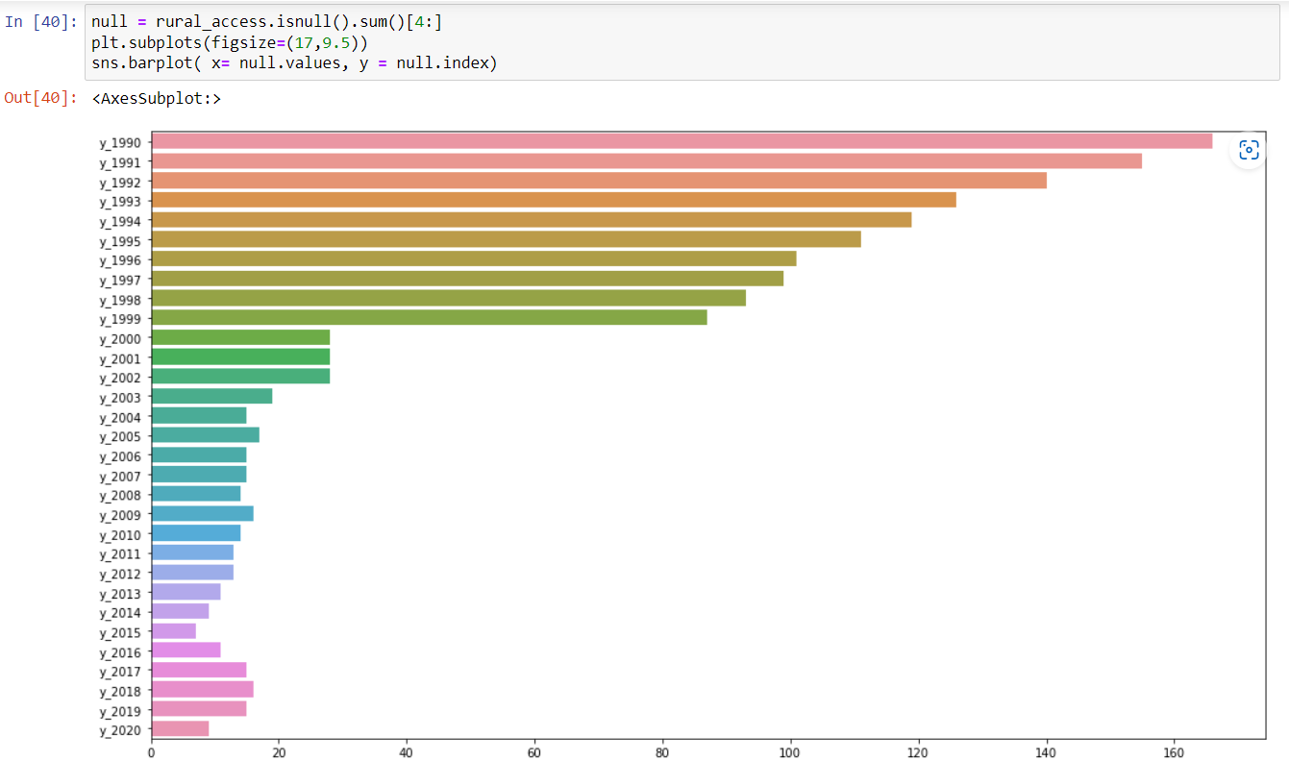
Missing values:-
As it is observed from the bar plot the missing values in the year 1990 are 166, which is too many missing value errors because the total records are 266, so 62.5% of 1990 data isn’t available.
And drops to 87 by 1999 (32.7%) but in the year 2000 the number of missing values comes to 28 only (10.5%).
So, to reduce error we use post 2000 data for most of the analysis.

Slide 4
Income-wise electrification in urban, rural and total population
In high-income countries, the government takes care of all classes of people, i.e. rural and urban. That’s why both urban and rural are almost equally utilize electricity.
As wealth drops, the utilization percent difference between urban and rural increases.
Thus the low-income country thrives to provide electricity to each and everyone, so urban citizens utilize but for the rural area only a few percent are covered by electrification, whereas the percent of the total population is also because in the low-income country most of the population belongs to a rural area.

Slide 5
Number of countries with more 75% of population
It is clearly visible that the number of countries with more than 75% population utilizing electricity becomes twice in the span of 30 years.
Urban population (red bar), 1990 – 96 countries, 2020 – 191 countries
Rural population (blue bar), 1990 – 84 countries, 2020 – 160 countries
Total population (line), 1990 – 93countries, 2020 – 167 countries

Slide 6
Region-wise & income-wise electrification
The wealth of the countries play an important role in the selection of resources. Nuclear energy and renewable energy electrification are highly expensive than others.
Percent of nuclear resource utilization is higher in high-income countries whereas this percentage drops with a decrease in the wealth of the country.
Apart from the high-income country, oil is preferable in low-wealth regions.
If you see region-wise, gulf countries mostly use oil resources because of the availability of abundant oil in the region.

Slide 7

Electricity production from different sources
There are different sources, which are oil, nuclear, renewable, coal, etc. The whole world is decreasing the production capacity of electricity through oil, coal, and other non-renewable resources because of the climate crisis and the low availability of sources.
Nuclear source - From the below chart, it is inferred that nuclear electric production increased from 1980 to 1995-1996 then afterward the utilization percentage of nuclear sources decreased.
Oil source – Oil source contributes to a huge amount of carbon emission and environmental pollution plus due to limited resource availability whole world is turning towards other sources of electricity, That’s why the percentage of electric generation through oil has decreased from 15% to 3.27% (1980 – 2020).
Electric power and distribution loss – It seems like the percentage of power loss remains the same throughout the last 40 years, which is almost 8.25-8.26 %.

Slide 8
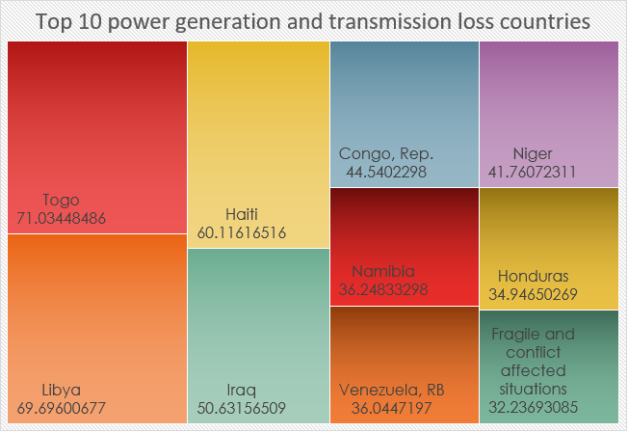
Top 10 countries who contribute to the power generation loss:-
The higher percentage of power loss is due to the presence of poor management by the government of the country in past or in the present.
As you can see from the top 10 countries where the government isn’t functioning well enough to manage war crises, social conflicts, economic instability, or poverty.
Togo, Libya, Iraq, Haiti, etc countries are involved in social conflicts and war-like situations. And Venezuela is suffering from financial instability.

Slide 9
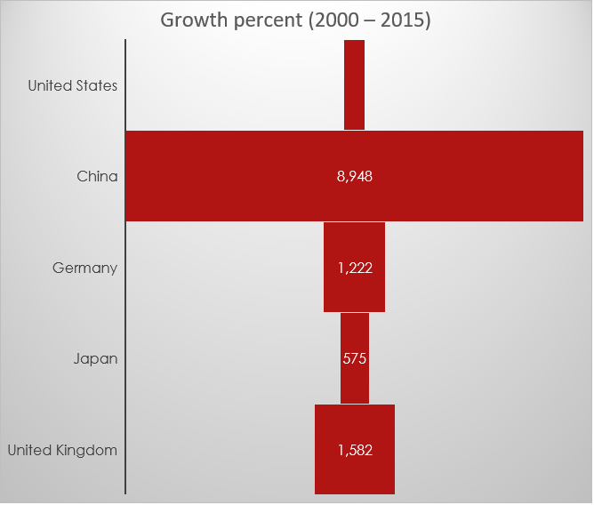
Renewable energy production:-
These are the top 5 countries from the 2015 data that are the major player in the generation of electricity with renewable resources.
The United States is holding first place in renewable energy utilization. But the growth rate is slower than other countries.
Whereas China's growth rate is far better. In 2000, China was in 16th place but in 2015 it comes in second place with an 8947 % growth rate in 15 years.
United States | 317000000000
China | 284000000000
Germany | 168000000000
Japan | 80292000000
United Kingdom | 77262000000

Slide 10

Country comparison with world:-
india
Pakistan
In 2000, both India (58%) and its neighboring country Pakistan (70%) both lagged behind the total world percentage (78%) of the population utilizing electricity but India surpasses the world average in 2015 and almost 99% population of India has electric access.
Whereas Pakistan’s condition remains the same with a slight change from 2000 to 2020 which is 70 to 75% only

Slide 11
Total % of population utilize electricity from group of countries:-
Here we can conclude by plotting the top 30 groups of countries, we can observe that for the 30th position electricity is utilized by only 63.3% of the population, whereas in 2020 the ratio increased to 90.1%.
In 2000, overall 78.22% of the total world population utilize electricity and the percentage goes up to 90.5% in 2020. This shows an increase of 15% in 20 years.

Slide 12
Group of countries’ electrification (Top 30)

Slide 13
Thank you

